Slide 1
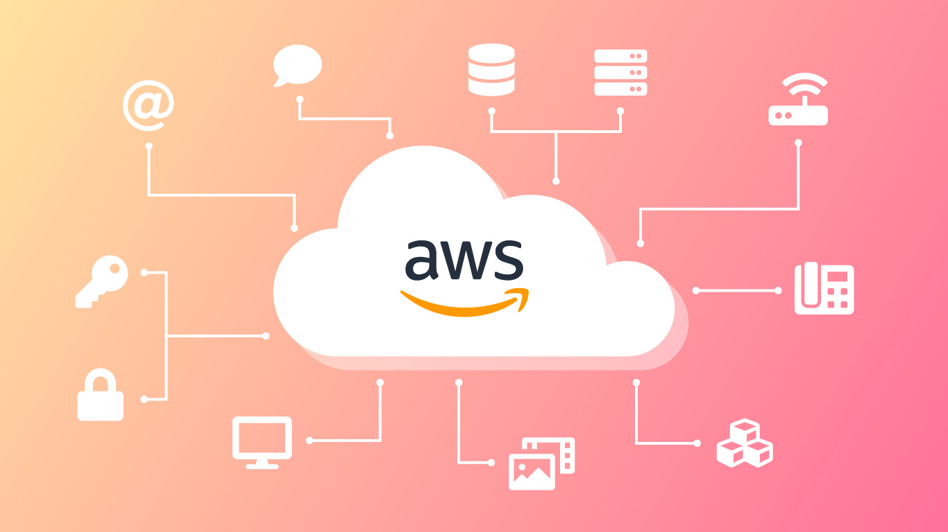

Introduction to AWS CloudTrail

Slide 2
Cloud Trail
What is AWS CloudTrail?
A service that records AWS API calls and events for your account.
Provides governance, compliance, and auditing capabilities.
Purpose of CloudTrail:
Enables tracking of user activity and changes in AWS resources.
Assists in security analysis and troubleshooting.

Slide 3
Key Features of AWS CloudTrail
Comprehensive Event Logging: Records API calls made via AWS Management Console, SDKs, CLI, and other AWS services.
Event History: Provides a history of AWS API calls for up to 90 days.
S3 Bucket Integration: Delivers log files to an S3 bucket for storage and analysis.
Multi-Region Support: Tracks API calls across multiple AWS regions.
CloudTrail Insights:Detects unusual activity by analyzing trends in API usage.

Slide 4
Benefits of AWS CloudTrail
Enhanced Security: Monitors and records all user activity, helping to detect unauthorized access.
Compliance and Governance: Helps meet compliance requirements by providing a record of AWS API activity.
Operational Monitoring: Assists in troubleshooting by providing detailed event history.
Cost Management: Identifies unauthorized resource usage to optimize costs.

Slide 5
How AWS CloudTrail Works
Event Capture: Captures API calls as events.
Log Delivery: Stores logs in Amazon S3.
Event Viewer: Allows viewing of events in the CloudTrail console.
Integration: Works with AWS services like CloudWatch for monitoring.

Slide 6
Common Use Cases
Security Monitoring: Detect suspicious activities and unauthorized access.
Compliance Audits: Provide auditors with detailed logs of user actions.
Resource Tracking: Monitor the use of AWS services for cost management.
Operational Troubleshooting: Identify the cause of operational issues through log analysis.

Slide 7
Security and Best Practices
Enable CloudTrail in All Regions: Ensure global coverage of logs.
Encrypt Log Files: Use AWS KMS to encrypt log files for security.
Integrate with CloudWatch: Set up alerts for specific API calls or activities.
Regularly Review Logs: Consistently monitor and review logs for anomalies.

Slide 8
Conclusion
AWS CloudTrail is essential for monitoring and securing AWS environments.
It provides detailed visibility into API activity, supporting security, compliance, and operational efficiency.
Regular use of CloudTrail helps ensure that your AWS account remains secure and compliant.

